Slide 1
What impacts does tectonic activity have on our planet?

Slide 2
Homelearning
You will need to complete the other parts of your cases study sheet.

Slide 3
Which plate boundary does each person live near?
‘My city suffered major earthquake damage in 1906 and 1989. Thank goodness we don’t have volcanoes as well’.
‘My grandparents were killed in a huge earthquake in 1988. Big earthquakes are common here in the Himalayas.’
‘My island was created by a volcano and we still have regular eruptions. Last week I felt a small earthquake, but they’re not too bad.’
Can you come up with a quote from the missing boundary?

Slide 4
By the end of the lesson:
All pupils will understand why some tectonic hazards become disasters
All pupils will understand the primary and secondary impacts of a natural disaster
All pupils will be able to identify the social, economic and environmental impacts of a Volcanoes.

Slide 5
‘Not all natural hazards are equally devastating.’
In your pairs discuss this statement.
What is it suggesting?

Slide 6
Look at the set of figures on your table
date | Place | time | magnitude | deaths
Sept 18 2011 | Nepal | 12.40 | 6.9 | 111
July 10 2011 | Honshu/Japan | 00.57 | 7.0 | 0
Feb 21st 2011 | Italy/Christchurch | 23.51 | 6.3 | 181
April 2009 | Italy/Rome | 1.32 | 6.3 | 294
Jan 1995 | Kobe/Japan | 5.42 | 6.8 | 5000
May 2008 | Sichuan/China |  | 8.0 | 70 000

Slide 7
The impacts a tectonic hazard has on an area varies on …………
The strength of
an earthquake/volcano
The time the event took place

Slide 8
Create a mind map explaining why?
?
They could be asleep
Which means there is
less reaction time
If it is very early in the morning people
will be less prepared
The strength of
an earthquake/volcano
The time the event took place

Slide 9
What impacts do tectonic hazards have?

Slide 12
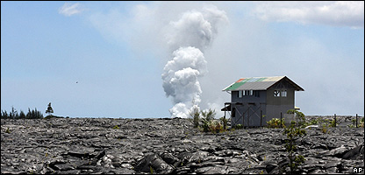
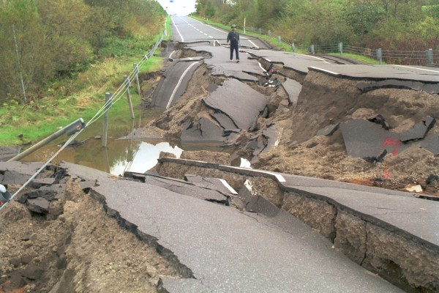

Slide 13
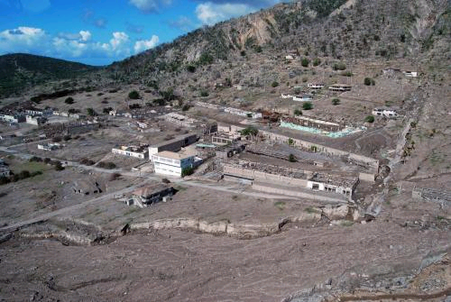

Slide 15
Write the impacts down on the white board?
What are the social, economic and environmental impacts of tectonic activity?
What do these words mean?

Slide 16
Are the impacts primary or secondary?
Broken pipes lead to fires, which destroy buildings | Buildings are reduced to rubble by the shaking ground
Family members may be split up | Bridges across rivers collapse
Roads are damaged and impassable | Aftershocks threaten to destroy weakened buildings
Closed roads lead to congestion and traffic chaos | Falling debris and glass cause injuries
Lack of water causes more diseases | Infrastructure for trains is damaged
People are killed by flying debris | There may not be any electricity, gas or fresh water.
 | Homeless people have to sleep outside in the cold

Slide 17
A primary impact is ………………………….
(Add examples)
A secondary impact is ………………………..
(add examples)
An economic impact is ………………………….
An environmental impact is ………………………
A social impact is ……………………………

Slide 18
It is important to find out about the different impacts a tectonic activity has on different countries.
Why??
If we understand the impacts in different countries this may help them prepare better in the future.

Slide 19
You will be working individually and then in pairs to create 2 case studies.
Each of you are going to complete a case study.
One will be of an earthquake in a MEDC and the other an volcanic eruption in a LEDC
In order to do this you need to understand what information you need and select the correct information from the source

Slide 20
Look at the information you have both collected
Can you compare the impacts of the volcano and the earthquake in each of your areas.
What were the major differences and why?

Slide 21
Share information
You are now going to meet someone else from the class.
You are going to share the information and discuss what the differences are between the 2 areas.

