Slide 1
Population Dynamic
Revision

Slide 2
Describe the different rates of population growth between 1500 and 2183 Page 147
It rose slowly to 1927
The rate of growth speeded up over time
It rose rapidly after 1927
The period taken to increase by 1 billion has reduced in almost a decade

Slide 3
Explain how natural increase is affected by both birth rates and death rates (4)
Birth rate must exceed death rate for natural increase to occur (1)
Where births greatly exceed deaths then the population grows rapidly (1)
Baby booms can cause a rapid increase (1)

Slide 4
What do the following terms mean?
Birth rate
Death rate
Natural increase

Slide 5
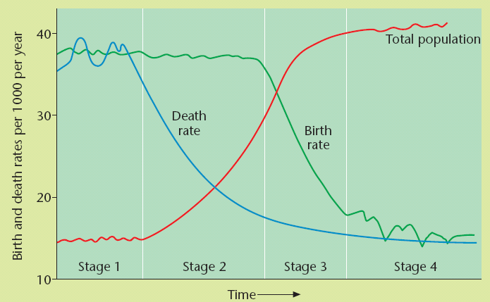
Can you explain what happens at each stage?

Slide 6
Using examples, describe how natural increase in population can change as a country’s level of development increases
The decline in birth rate as GDP increases because women prefer to have fewer children and go out to work and earn money for their family
The fall in death rate as a country develops, as well as infant mortality due to more money being invested in health care and people being seen quickly and cured when they are ill.

Slide 7
Page 153
Why is Russia’ s population decreasing?
Falling life expectancy due to alcoholism and industrial disease
Outward migration of young men and women
Why is Yemen’s population increasing?
Early marriage of women
Low literacy rates
High fertility rates

Slide 8
Using named examples, explain the factors that lead to either a natural population increase, or, natural population decrease (4)

Slide 9
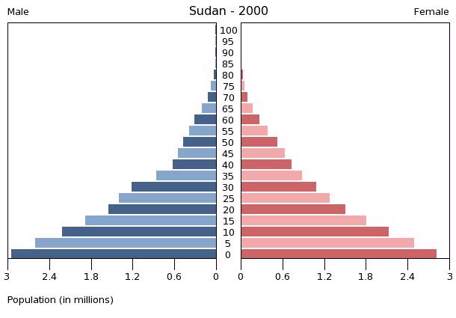
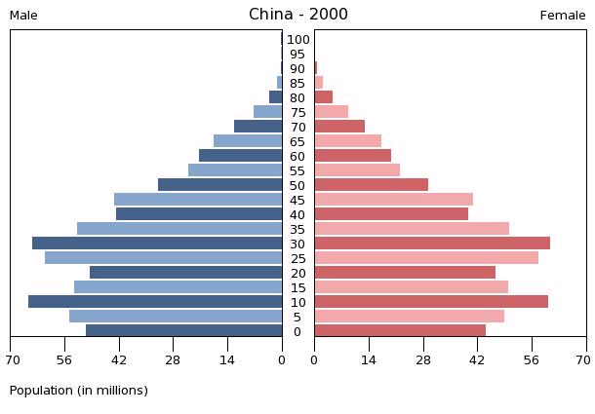
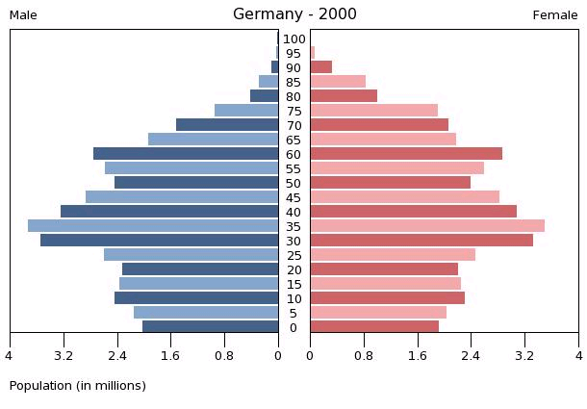
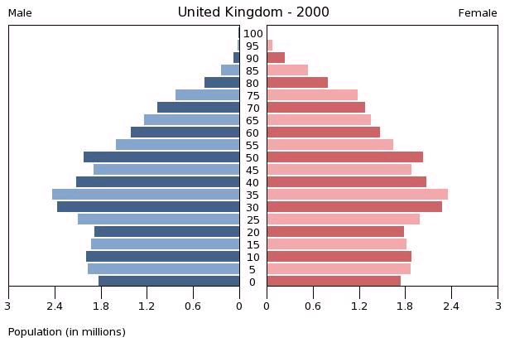
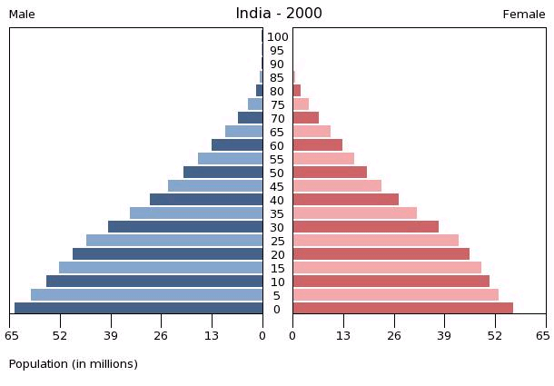
What do these population pyramids show? Where do they belong in the DTM?
Task Time: 5 mins

Slide 10
Aging population
What case study can you use?
Japan or Devon UK

Slide 11
Working population

Slide 12
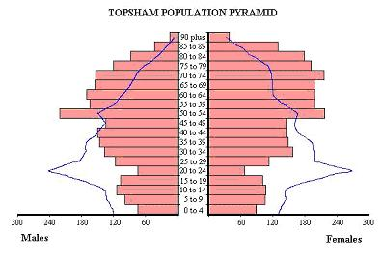
Connector - Devon Population pyramid
Blue line = national average population structure
1. Where does this country belong on the DMT?
2. What do the pyramids tell you about the population structure of the country?
3. Sketch what the pyramid will look like in 50 years time

Slide 13
What problems does an ageing population bring?
medical facilities
Implications of an
ageing population on…..
Services
Tax

Slide 14
Using a named example, outline two problems faced by countries with an ageing population (4)
Increased coast of pension (1) as more people live longer (1)
Fewer workers in the economy (1) so higher taxes are needed to fund pensions (1)
Increase in cost of care in nursing homes (1) and decline in health (1)

Slide 15
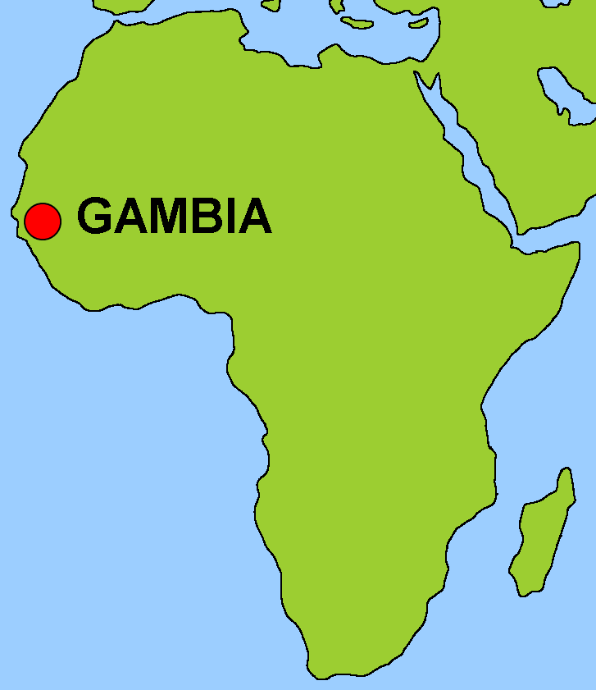
Where is Gambia?

Slide 16
Factfile for Gambia and UK in 2009
 | Gambia | UK
Population million | 1.8 | 61,113
Growth rate | 2.6 | 0.3
Births per women | 5 | 1.7
Birth rate per 1000 | 38 | 11
Life expectancy | 54 | 79
Infant mortality | 69 | 5
Death rate | 22 | 10

Slide 17
Problem | Solution | How this will work | Issues that may arise
1
2

Slide 18
 | Gambia | Devon
Population type | Aging/Young | Aging/Young
Reasons for pop type
Problems caused
Solutions to problems (sustainability)
The future

Slide 19
The second question should written in the form of a mind map
Very few medical facilities
Problems in Gambia
Youthful population
You will complete the mind map after you have watched the first 2 parts.

Slide 20
This has a negative effective on the...
This could lead to...
Too little population and there are not enough people for the jobs
Too high a population and resources such as .... may run out
A youthful population puts pressure on...
Why manage population?
This means the government has to spend money on.... instead of...
Lots of immigration puts pressure on...
High rates of emigration means...
The country could lose its skilled work force
Therefore governments act to keep skilled workers by...
This means...

Slide 21
How can we manage populations?
Pro-natalist policies include incentives to encourage people to have children eg. Financial payments (ie…)
Anti-natalist policies encourage people to have fewer children eg. by providing free state education for only the first child in the family/1 child policy

Slide 22
Using examples, explain why some countries choose to increase their population, but others choose to reduce it.
To increase working population (dev) to balance an ageing population (dev) so that there are more people working to support dependants e.g. Singapore
To ensure there are enough workers for the future economic growth (dev) to balance outward migration (dev) so there are more people paying taxes e.g. Russia
To reduce populaton pressure (dev) because of pressure on housing/health/services (dev) which affects quality of life e.g. India/China

Slide 23
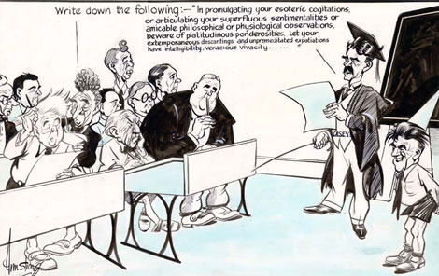
Migration Policies
Skills test, Quota, Open door policy

Slide 24
Migration policies Open door policy
Why would countries adopt an open door policy?
Can you think of any examples?
What are the advantages and disadvantages?

Slide 25
Explain how some countries use population policies to limit their population growth (6)
Ante-natal e.g. China’s one child policy (dev) which limits the number of children families can have by law (dev) and which can be extended by offering tax or cash benefits.
Migration controls e.g. strong limits on immigration/skills tests (dev) because of the pressure on housing if the population rises too rapidly (dev) and controlling immigration is one of the ways to prevent young people who might marry and have children from entering the country

Slide 26
Describe two potential advantages and disadvantages of having a large immigrant population (4)
Advantages
It can prevent labour shortages
Cultural benefits e.g. greater variety of food/music
Balances an aging population
Economic boost to the country with more people in work
Disadvantages
Place a strain on the welfare/healthcare system
Local people find it difficult to compete in the job market
Immigrants often remain isolated and separate form the community

Slide 27
Using examples, explain how some countries try to increase immigration, whilst other countries try to reduce it (6)
To expand skilled labour e.g. Australia (dev) in order to create economic growth (dev) which means a country can develop its industries and provide high-quality services e.g. education and health
To combat an ageing population (dev) as there will be more people to work and pay taxes towards pensions (dev) and if they’re young, they’ll marry and have more children to balance the popualtion
Reduce
To reduce unemployment amongst a country’s population (dev) as immigrants could compete for jobs (dev) especially as they are often prepared to work for lower wages.

