Slide 1
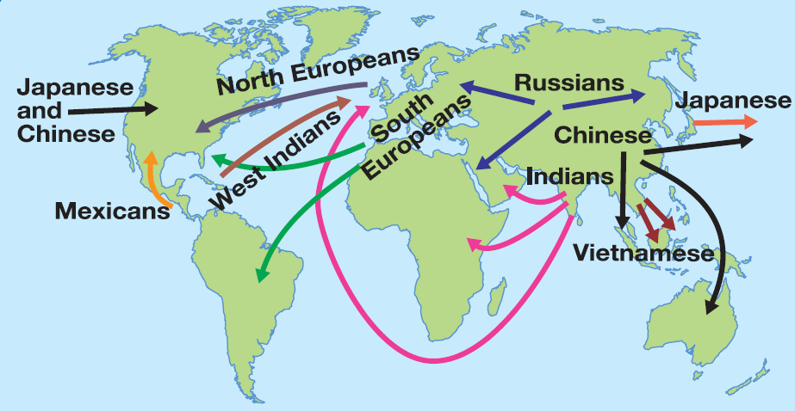
What is migration?
How can you manage it?

Slide 2
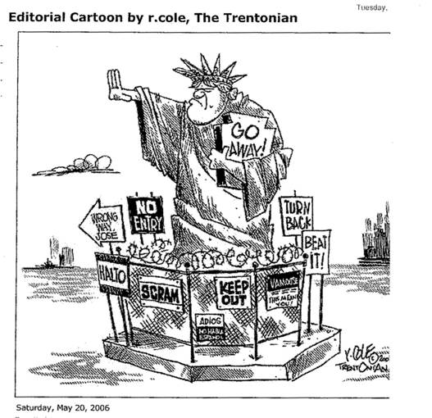
Connector
Define these words:
Migration
Immigration
Emigration

Slide 3
Why do you think people migrate?
Migrating is not easy and people need to have good reasons for moving. These can be divided into two groups:
Push factors
Pull factors

Slide 4
Immigration on the Mexico – US border
Push Factors Pull Factors
(from Mexico) (to USA)
Poor medical facilities – 1800 people per doctor
Many jobs available for low paid workers such as Mexicans
Well paid jobs (GNP = $24,750)
Life expectancy 76 yrs
Low paid jobs (GNP = $3750)
Adult literacy rates 55% - poor education prospects
Life expectancy 72 yrs
Excellent medical facilities – 400 people per doctor
40% Unemployed
Adult literacy rates 99% - good education prospects

Slide 5
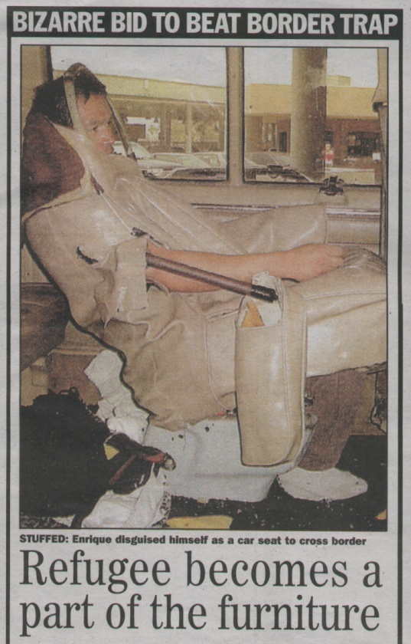

Slide 6
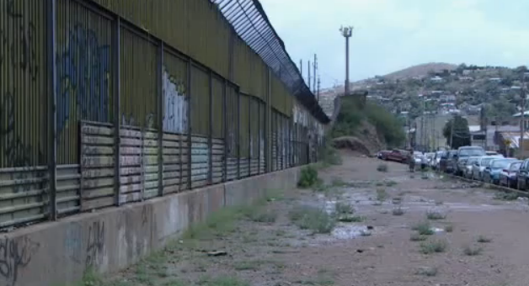
Mexico – usa migration

Slide 7
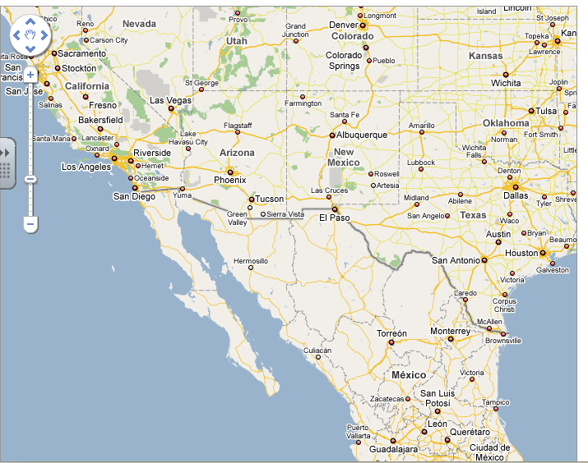

Slide 8
What is the situation?
There is a 2000km border between USA and Mexico.
1 million + Mexicans migrate to the USA every year.
Illegal migration is a huge problem for USA and Mexico
US Border Patrol guard the border and try to prevent illegal immigrants
850,000 were caught in 1995 and were deported

Slide 9
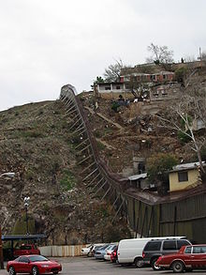
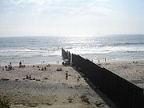

Slide 10
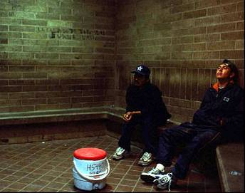
Review –
Complete the speech bubbles
I wanted to go to the USA because…
(include good points about the USA)
I wanted to leave Mexico because…
(include bad points about Mexico)

Slide 11
MANAGING MIGRATION
Why do some countries want to encourage migration?
Why do some countries want to limit migration?

Slide 12
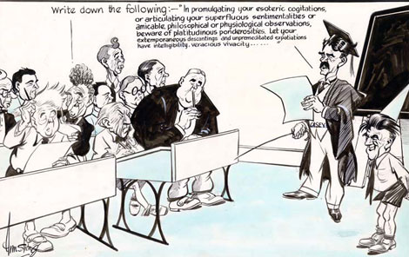
Migration Policies
Skills test

Slide 13
Migration policies open door
Why would countries adopt an open door policy?
Can you think of any examples?

Slide 14
Exam questions
Describe two methods governments can use to change the numbers of migrants arriving in a country. (2)
Explain why migration policies vary from country to country. (4)
Explain why governments may wish to control the number of migrants entering their country.(2)
Describe the tensions that can arise from different migration policies.(4)
Describe how skills tests are used to limit the numbers of migrants allowed into a country. (3)

