Slide 1
Changing Cities:
London: a growing city
Thursday, 21 March 2013

Slide 2
Homework. Due next lesson.
Complete the Bedzed worksheet

Slide 3
Coming up
London, a growing city. Good or bad?
Rubbish- where does it go?
Evaluating rubbish disposal methods
How to reduce eco-footprints
Bedzed: a sustainable approach?

Slide 4
In the next 90 minutes
All students will:
Evaluate different viewpoints about the growth of London
Describe where London’s rubbish goes
Evaluate the advantages and disadvantages of different waste management schemes
Describe and explain ways of reducing eco –footprints
Evaluate Bedzed

Slide 5
To start
Match the continent to its eco- footprint:
Europe
Africa
North America
Asia

Slide 6
To start
Check your answers
Extra: how might these footprints change by 2035? Why?

Slide 7
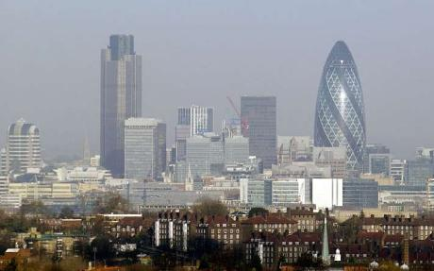
London: some facts.
Produces 9% of UK GDP (Gross Domestic Product)
4th largest urban economy in the world
What will this mean for London? Good? Bad?
As prosperity increases more people will come to live and work, needing more energy, food, homes and transport- this will put strain on people and the environment

Slide 8
London, a growing city. Good or bad?
INPUTS
FOOD
6.9 million tonnes pr. Yr
WATER
866 billion litres pr yr
94 million litres of
bottled water in 2260
tonnes of plastic
ENERGY
13.2 million tonnes
oil equivalent made up of
21% electricity
23% liquids
55% gases
<1% renewable
CONSTRUCTION
MATERIALS
20 million tones
WORKERS
3 million daily commuters
49 million
tonnes
of materials
consumed
OUTPUTS
WASTE
40.9 million
Tonnes of CO2
27 million tonnes
of food, construction
And demolition
Materials,
Manufactured goods,
chemicals, etc
Inorganic waste into
landfill
Organic waste into
Rivers
28% of all water
is lost through
Leakage
18% of all
energy is wasted
MANUFACTURED GOODS
14 million tonnes
of manufactured goods,
Food, building
Materials, etc
In your books, explain
how each of the
following people would
see this situation
Environmentalist
Economist
Londoner
64 billion
Passenger km
travelled each year-
69% by car

Slide 9
London, a growing city. Good or bad?
An environmentalist would / would not like London’s growth. This is because ____ resources will be required leading to_____
An economist would be happy / unhappy because _______
A Londoner’s view is that the growth of London is ________

Slide 10
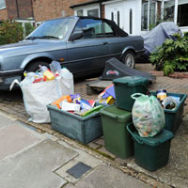
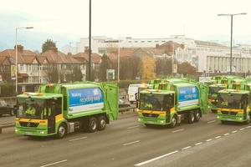
This lesson is rubbish!
Londoners produce 2 million tonnes of waste a year! Where does your rubbish go?
Use pages 209 – 211 to identify where our rubbish goes.

Slide 11
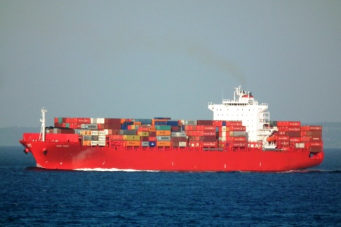
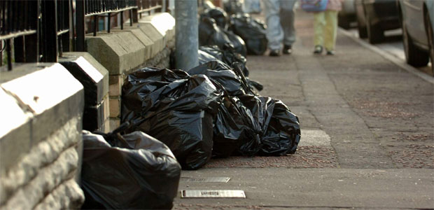
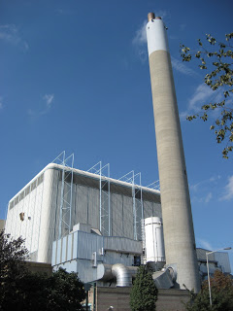
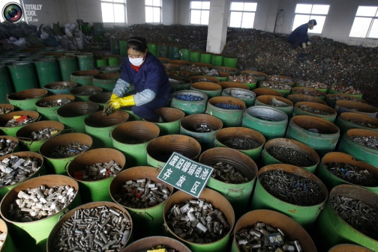
Where does our rubbish go?
The front gate
Train from Southall
Landfill in Calvert
Waste to Energy plant Millwall
The front gate
Container ship
Chinese factory

Slide 12
Task
Using pages 209 – 211 identify the advantages and disadvantages of:
Landfill
Recycling
Waste to Energy
You can present your work as a table or a series of paragraphs.

Slide 13
Task: Using pages 209 – 211 identify the advantages and disadvantages of different types of rubbish disposal:
Advantages
Landfill | Recycling | Waste to Energy
Cheap
Uses old quarries
Completed sites can be used for parks
Reduces CO2 emissions
Methane is a cheap fuel
Provides cheap electricity
Will last a long time
Stops deforestation for new raw materials
Councils do not have to pay landfill tax

Slide 14
Task: Using pages 209 – 211 identify the advantages and disadvantages of different types of rubbish disposal:
Disadvantages
Landfill | Recycling | Waste to Energy
Attracts seagulls
Can be smelly
Chinese workers may be exploited
Increased CO2 emissions
Can create heavy traffic
Does not get rid of all waste
Dangerous chemicals can leak into water supply

Slide 15
Practice Question
Using examples, explain how the footprints of cities often extend way beyond the city boundaries (4 marks)

Slide 16
Attempts to reduce a city’s eco-footprint
How can a city reduce it’s eco-footprint?
Action can be taken by individuals and the government.
What should each group do?
Individuals | Government

Slide 17
Attempts to reduce a city’s eco-footprint
How can a city reduce it’s eco-footprint?
Action can be taken by individuals and the government.
What should each group do?
Individuals | Government
Buy “local” seasonal food
Provide recycling facilities
Improve public transport
Reduce car use
Provide grants for home insulation
Develop sustainable energy sources
Use a refillable water bottle
Have holidays in GB

Slide 18
Task
Select 2 actions for each group.
Explain how each action will reduce the eco-footprint of London.

Slide 19
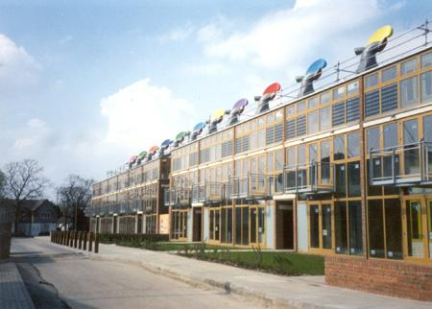
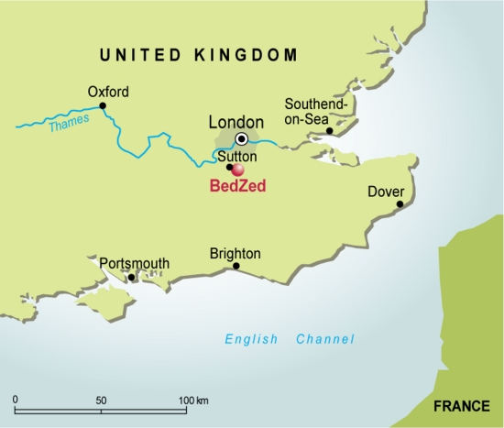
Is BedZed a sustainable solution for London?
The Beddington Zero Energy Development (BEDZED) near Croydon, Greater London, is the largest carbon-neutral eco-community in the UK. It is built on reclaimed land and focuses on social and environmental sustainability, while promoting energy conservation.
It is known as ‘eco-town’ and is built on a brown field site (an area that has already been built on) so when it was built, it did not damage any eco-systems.

Slide 20
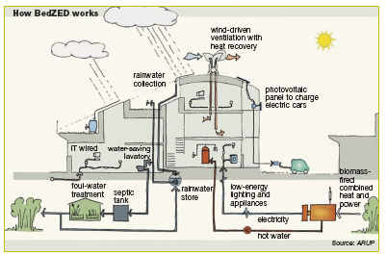
Homework. Due next lesson.
Annotate each feature of Bedzed to explain how it is reducing the eco-footprint.
What other features would you introduce to further reduce the eco footprint?

Slide 21
Finally
These are the answers. What are the questions?
The USA
Dangerous chemicals can leak into water
Nice parks are created
China

