Slide 1
Managing coastal erosion
Tuesday, 17 April 2012

Slide 2
Homework from last lesson.
Explain the process of longshore drift. You may use a diagram to help with your answer (4)
Peer assess your answer.

Slide 3
Sizeable portrait
Coasts are a dynamic environment subject to constant shaping and reshaping by the actions of the waves.
In this lesson you will consider strategies used for managing coastal erosion. You will also consider how different coastlines should be managed.
The lesson will continue preparation for the Swanage field visit.

Slide 4
Coming up
All pupils can explain different coastal management strategies.
All pupils can identify hard and soft engineering.
All pupils can explain advantages and disadvantages of different coastal management strategies.

Slide 5
Vocabulary
Hard engineering
Soft engineering
Groyne
Sea wall
Beach
Managed retreat
Vegetation matting
Rip rap / rock armour
Gabions
Beach nourishment

Slide 6
How can coastal erosion be managed?
Coastal erosion cannot be stopped. All coastal defences have the following aims:
Reduce the number of waves reaching the coast
Reduce the speed and power of those waves that reach the coast.
Write the information above in your exercise book.

Slide 7
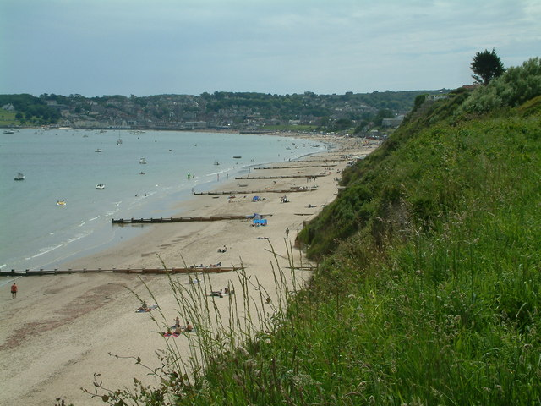
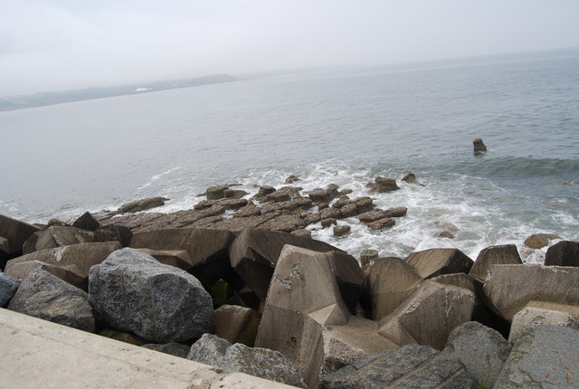
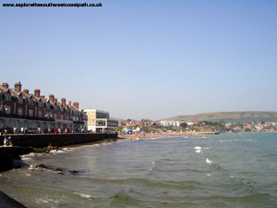
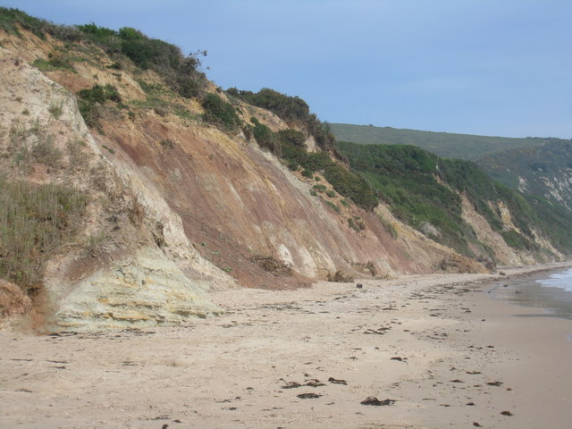
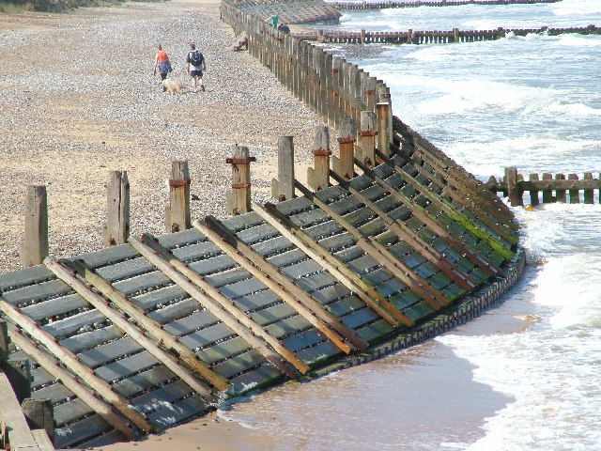
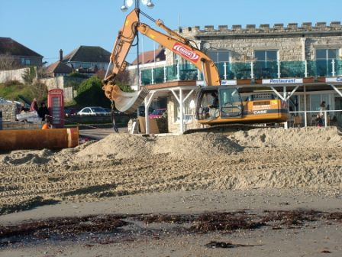
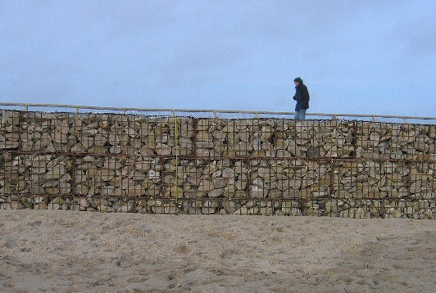
Coastal management strategies. Funding for most strategies comes from the local council
Groyne
Rip rap / rock armour
Sea wall
Do nothing
Gabions
Revetments
Beach replenishment

Slide 8
Task:
Complete the table about the different methods of coastal defence. Pages 84-87 will assist.
Defence | Description | How does it work? | Hard /soft | Cost | Advantages | Disadvantages
Sea wall | A large concrete wall built along the coastline | The waves hit the hard concrete not the soft material on the coast | Hard | £2000 per m. | Will stop virtually all erosion | Expensive to build
Groyne
Rip / rap
Gabions
Revetments
Beach replenishment
Do nothing

Slide 9
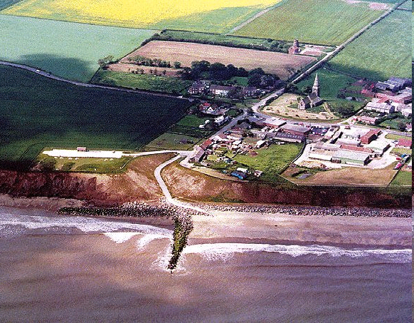
Which direction is longshore drift moving material in this photo? How do you know? What problems occur when you restrict longshore drift?
http://www.georesources.co.uk/coastman.htm

Slide 10
Task
Prevailing
wind
Study the map above. What impact might the coastal defences at Swanage have on other parts of the Dorset Coast? Explain your reasons

Slide 11
How do different stakeholders view coastal defences?
The decision to build coastal defences in a particular location is often very controversial, both in terms of whether the defences should be built and which type of defences should be installed.
For each of the following stakeholders answer the following questions:
How might the stakeholder feel about the plan to build a coastal defence?
Which kind(s) of coastal defence they would prefer?
Explain your choices
Local residents living on the cliff top
Local business selling goods and services to tourists
The local council
Local residents further along the coast
Conservationists
Local residents who do not live on the coast

Slide 12
How do different stakeholders view coastal defences?
Match the stakeholders below with the comment that best describes their view on coastal defence:
If they build their sea wall no material will be deposited here. Have they thought about us?
Local residents living on the cliff top
Local business selling goods and services to tourists
The local council
Local residents further along the coast
Conservationists
Local residents who do not live on the coast
Why is my council tax being spent on the coast. What about investing in this town?
A sea wall lasts a long time and will stop my house falling into the sea.
Building a beach is cheap and will mean that lots of tourists will visit.
We want to do the best for all residents and spend the council tax carefully
It’s futile to think we can stop erosion. Nature is too powerful. Wildlife along this coastline is too important to be disturbed by a coastal defence.

Slide 13
Did you get the correct answers?
Local residents living on the cliff top
Local business selling goods and services to tourists
The local council
Local residents further along the coast
Conservationists
Local residents who do not live on the coast
A sea wall lasts a long time and will stop my house falling into the sea.
Building a beach is cheap and will mean that lots of tourists will visit.
We want to do the best for all residents and spend the council tax carefully
If they build their sea wall no material will be deposited here. Have they thought about us?
It’s futile to think we can stop erosion. Nature is too powerful. Wildlife along this coastline is too important to be disturbed by a coastal defence.
Why is my council tax being spent on the coast. What about investing in this town?

Slide 14
Finally.
Are each of the following methods of coastal defence hard or soft engineering?
Sea wall
Groyne
Rip / rap
Gabions
Revetments
Beach replenishment
Do nothing

