Slide 1
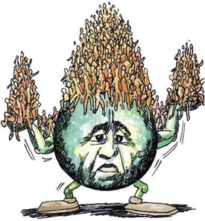
What are the alternatives?
Lesson 4
Visit again at www.fhsgeography.weebly.com
Monday, 28 January 2013

Slide 2
Homework, due next lesson. www.fhsgeography.weebly.com
Visit the Energy Saving Trust’s website and read the ways that you can reduce your carbon footprint around your home.
Explain how three actions (in three different rooms) will lead to you using less oil.
In your opinion is wind power or better energy efficiency more likely to be successful in reducing our dependency on oil?

Slide 3
Huge graphic
Oil is one of the most important resources on earth, but its supply is finite. This means it will run out.
This lesson examines how to deal with this, considering whether to develop alternatives or use existing resources in a more efficient way.

Slide 4
Coming up
What is reduce?
What is alternative?
Hydrogen or not?
Wind power or not?

Slide 5
To start.
Why should we reduce the amount of oil we consume?

Slide 6
To start.
Oil
Increased demand
Environmental cost
Dwindling supplies

Slide 7
Sustainable alternatives to oil.
It would be impossible for us to stop using oil and continue to enjoy are current standard of living.
We should aim to do the following:
Reduce our dependency on oil
Develop alternatives to oil

Slide 8
Sustainable alternatives to oil.
Define “reduce” and give an example.
Define “alternative” and give an example.

Slide 9
Sustainable alternatives to oil.
Reduce means:
Alternative means:
Sort each of these into the correct category: Reduce or Alternative
Develop other fuels e.g hydrogen | Create energy efficient appliances
Insulate homes | Introduce a charge for all plastic bags

Slide 10
Sustainable alternatives to oil.
Match the heads and tails
Reduce means
Alternative means
using something instead of oil
using less oil
Sort each of these into the correct category: Reduce or Alternative
Develop other fuels e.g hydrogen | Create energy efficient appliances
Insulate homes | Introduce a charge for all plastic bags

Slide 11
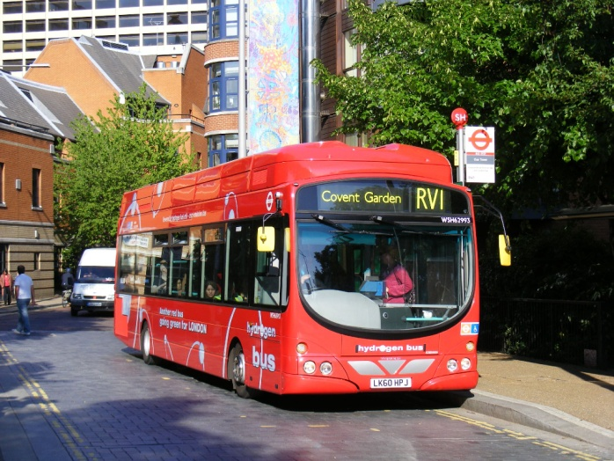
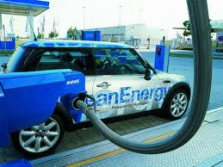
Reducing our use of oil
Transport is responsible for 27% of all CO2 emissions in the UK. Alternatives are being developed:

Slide 12
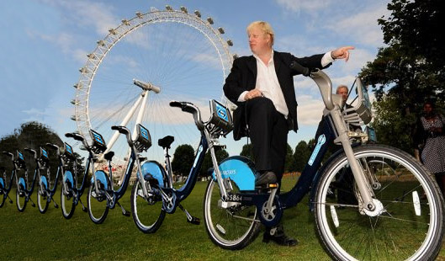
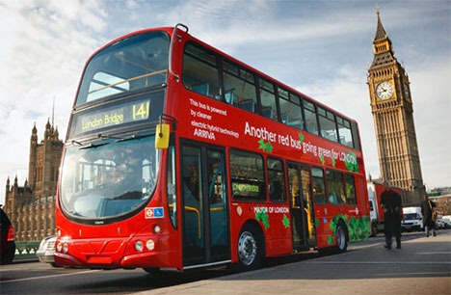
Case Study. Transport for London have taken the following measures to reduce our dependency on oil.
Bike hire scheme
Cheap fares
High frequency hybrid buses
Task: explain how TfL’s actions help reduce the amount of oil we use.

Slide 13
Case Study. Transport for London have done the following to reduce the amount of oil we use
Lots of buses
Bike hire scheme
Cheap fares
Task: explain how TfL’s actions help reduce the amount of oil we use.
A bike hire scheme means that we ______________. This means that when we travel we do not _________________.
Cheap fares encourages more people to _____________. This means that_____.
Lots of buses ___________.

Slide 14
Case study: hydrogen fuel.
Many engineers believe that using hydrogen to power vehicles is the best way to reduce our dependency on oil.
Watch the video about the Swedish Post Buses powered by hydrogen fuel cells. These are part of the “Clean Hydrogen in Cities” programme which also operates hydrogen fuel cell buses in London on route RV1.
What are the advantages and disadvantages of using hydrogen as a fuel? Page 166 in the textbook will also help you.

Slide 15
Task
“Hydrogen is the fuel of the future and always will be”
Adrian Wickens; Volvo; January 2013
Do you agree with this statement?
Explain your reason.

Slide 16
Case study: wind power
Electricity generation is responsible for 41% of all CO2 emissions in the UK. Alternatives are being developed:
Watch from 8:15 of this clip to find about wind power in California.
What are the advantages and disadvantages of using wind power to generate electricity?

Slide 17
Homework, due next lesson. www.fhsgeography.weebly.com
Visit the Energy Saving Trust’s website and read the ways that you can reduce your carbon footprint around your home.
Explain how three actions (in three different rooms) will lead to you using less oil.
In your opinion is wind power or better energy efficiency more likely to be successful in reducing our dependency on oil?

Slide 18
Finally.
Using examples explain how renewable energies could replace the world’s dependency on fossil fuels. (4 marks)

