Slide 1
How are different coastlines produced by physical processes?
Part 2: Waves
Monday, 19 March 2012

Slide 2
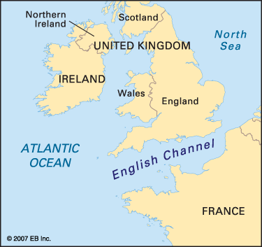
Homework, due next lesson.
What kind of waves do you think would happen at Swanage in January? Why?
How will the waves be different in July? Why?
Swanage

Slide 3
Homework from last lesson. What might happen at Stair Hole in the next 100 years? Use annotated diagrams to describe and explain how Stair Hole might change over the next 100 years. Exchange work with another student. What is good about the work you are marking? How could it be improved?

Slide 4
Sizeable graphic
Last lesson we learnt different coastlines are created by different physical processes, using concordant and discordant coastlines in Dorset as an example.
This lesson will begin to examine the role that waves play in shaping these coastlines.
The lesson will continue to prepare for the visit to Swanage where you will collect data for your controlled assessment.

Slide 5
Coming up
What are waves?
Are all waves the same?

Slide 6
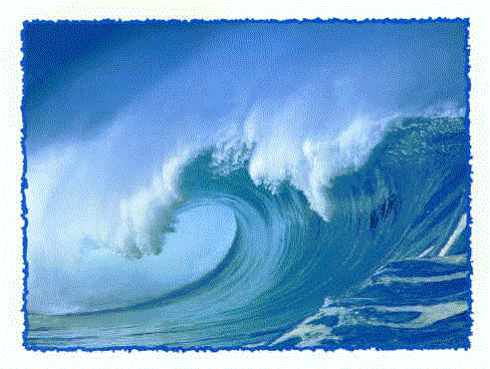
How would you describe a wave?

Slide 7
What is a wave?
A wave is a ripple across an area of water. Some waves are very small, whilst others can be huge; taller than the building you’re sitting in.
To understand why waves vary in size we need to understand three key ideas:
how long the wind has been blowing
the strength of the wind
the fetch (how far the wave has travelled)
Lets find out more.

Slide 8
How much did you understand? Which point will have the largest waves? Why?

Slide 9
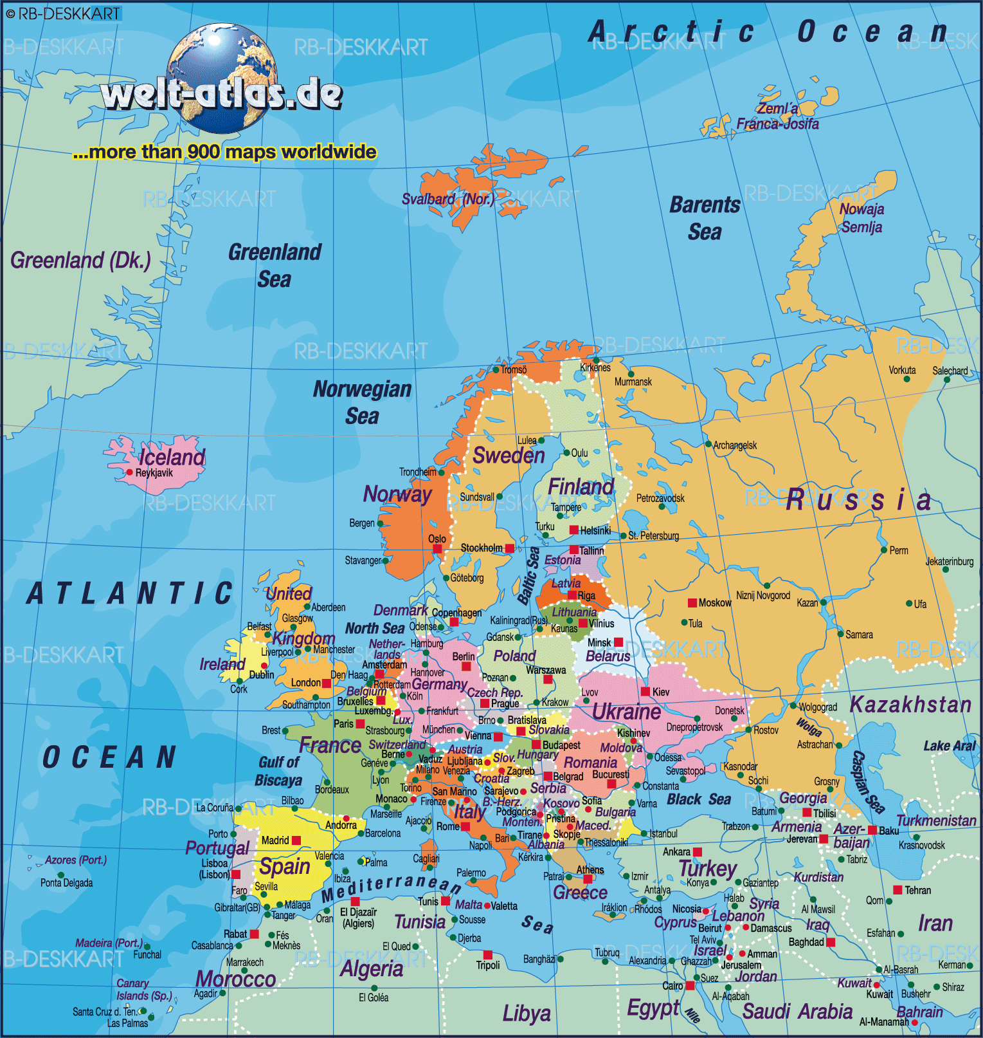
Task. Question 1 pp77

Slide 10
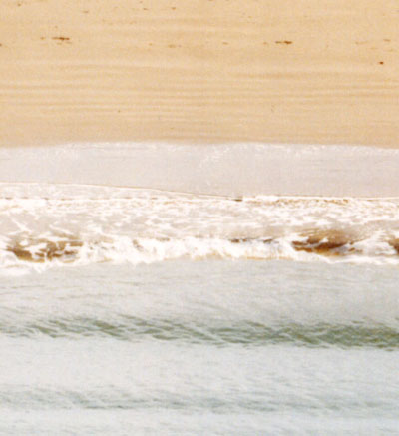
What happens when a wave reaches the beach? Swash and backwash
Backwash
Swash
The backwash is always at right angles to the beach.
Can you explain why?

Slide 11
Define “swash” and “backwash”
Your definitions should include the following:
The direction the wave moves and why.
Backwash
Swash

Slide 12
Create two sentences to define swash and backwash.
Swash is the
Backwash is waves
the beach blown by wind
moving down the beach
Backwash
wave moving up
Swash
at right angles due to gravity

Slide 13
Constructive and destructive waves
Waves breaking on a beach are either constructive or destructive.
Whether a wave is destructive or constructive depends on the fetch, wind strength and the size of the swash and backwash.
Can you create a hypothesis using the terms above to explain when a wave is destructive and when a wave is constructive?

Slide 14
Types of waves

Slide 15
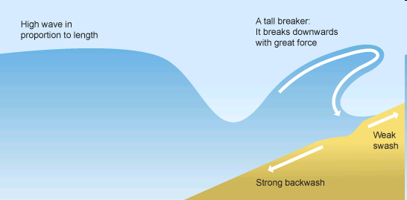
Destructive waves
A long fetch and strong winds produce Destructive waves. The back wash is stronger than the swash. They create steep beaches.

Slide 16
Constructive waves
Draw an annotated diagram to show how constructive waves occur. Include the following words:
Wind
Fetch
Swash
Backwash
A comment of the angle of slope.

Slide 17
To finish

